Slide 1
A Look At DISA STIGs (2)
STIG content:
General information (title)
Discussion
Check content
Fix text
CCI (References)

Slide 2
A Look At DISA STIGs (2)
SEVERITY | DISA CATEGORY CODE GUIDELINES
CAT 1 | Any vulnerability, the exploitation of which will directly and immediately result in loss of Confidentiality, Availability, or Integrity.
CAT 2 | Any vulnerability, the exploitation of which has a potential to result in loss of Confidentiality, Availability, or Integrity.
CAT 3 | Any vulnerability, the existence of which degrades measures to protect against loss of Confidentiality, Availability, or Integrity

Slide 3
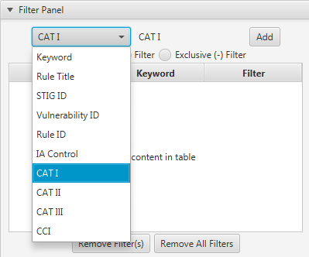
A Look At DISA STIGs (2)
FILTER PANEL

Slide 4
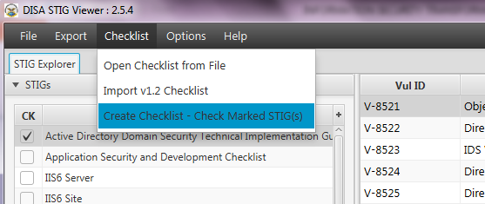
A Look At DISA STIGs (2)
CREATE CHECKLIST

Slide 5
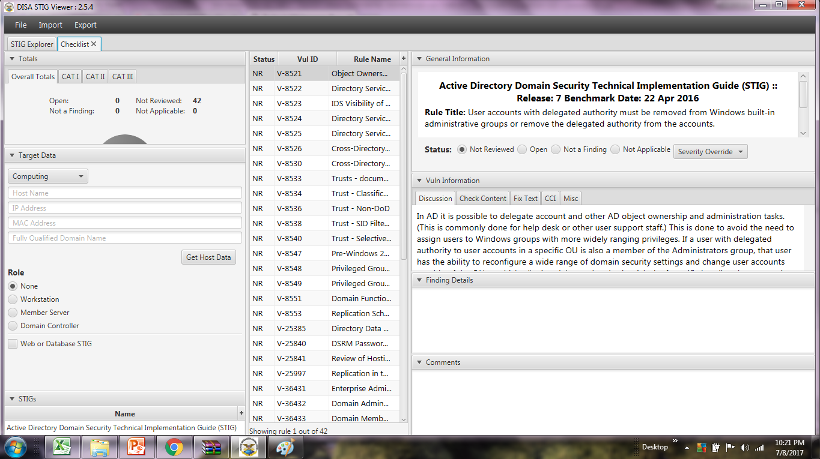
A Look At DISA STIGs (2)
CHECKLIST

Slide 6
A Look At DISA STIGs (2)
Checklist screens:
Overall totals
Target data
Role
Finding details
Comments

Slide 7
A Look At DISA STIGs (2)
Checklist screens (STATUS):
Not reviewed
Open
Not a finding
Not applicable

Slide 8
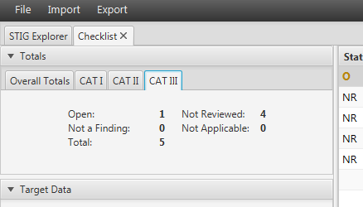
A Look At DISA STIGs (2)
Totals

Slide 9
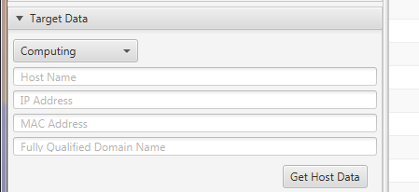
A Look At DISA STIGs (2)
Target Data

Slide 10
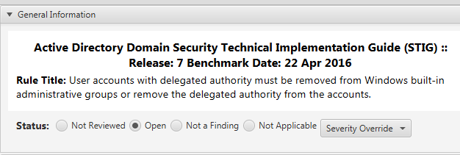
A Look At DISA STIGs (2)
Status

Slide 11
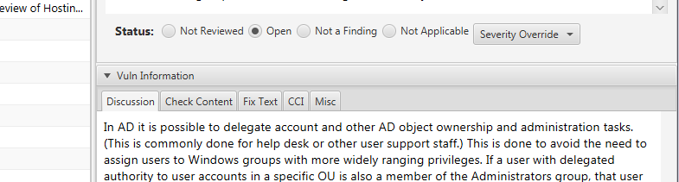
A Look At DISA STIGs (2)
Vuln Information

Slide 12
A Look At DISA STIGs (2)
In the next module lets look at further details
END

